Slide 1
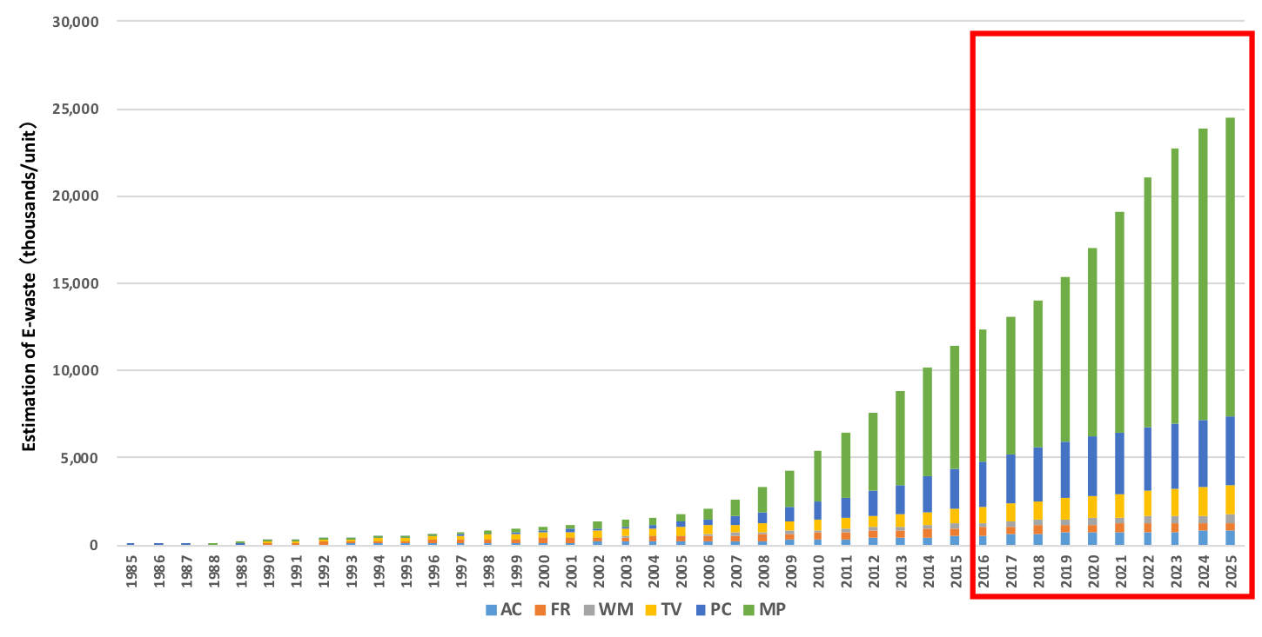
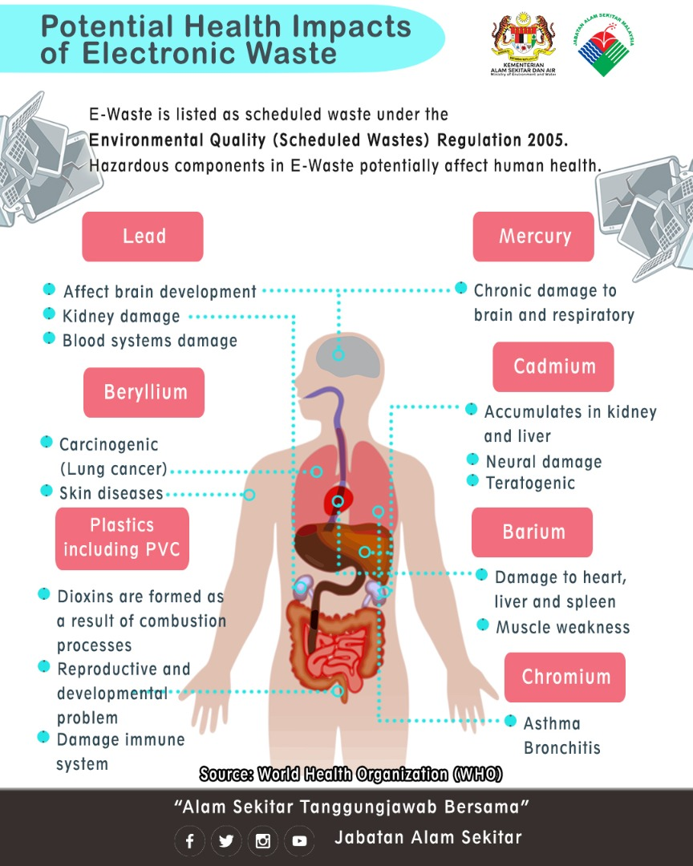
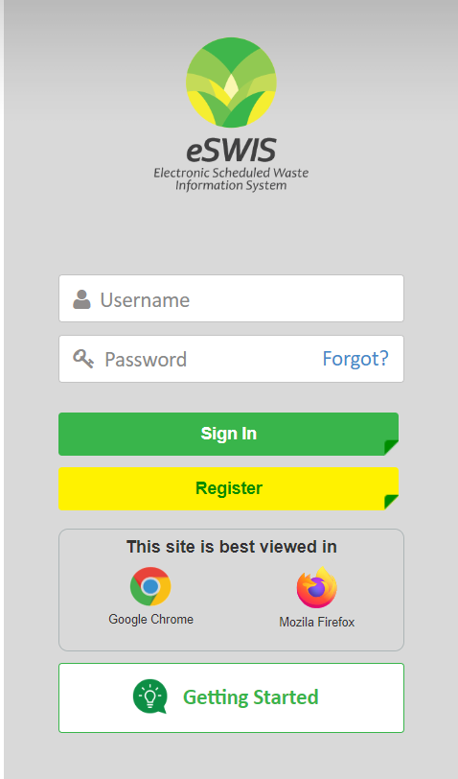
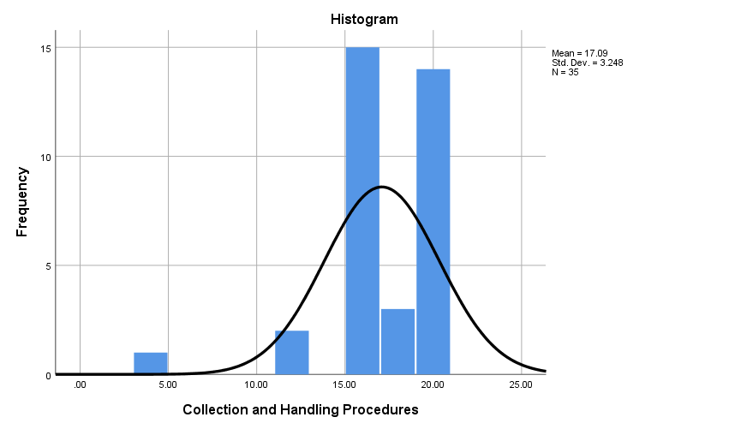
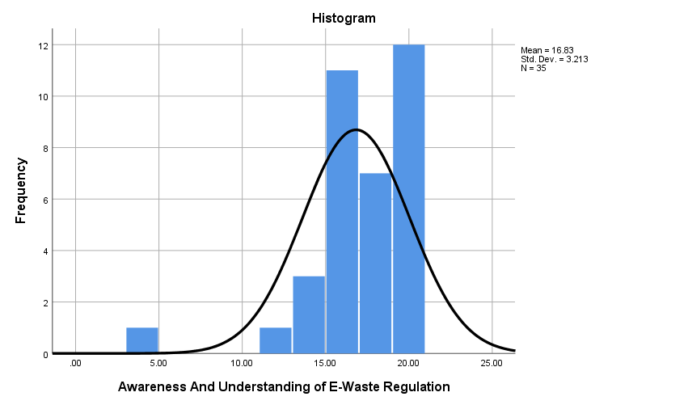
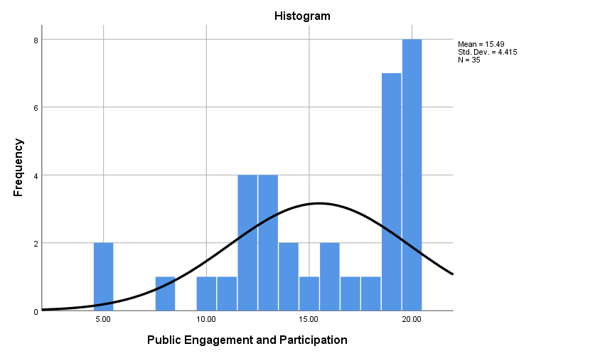
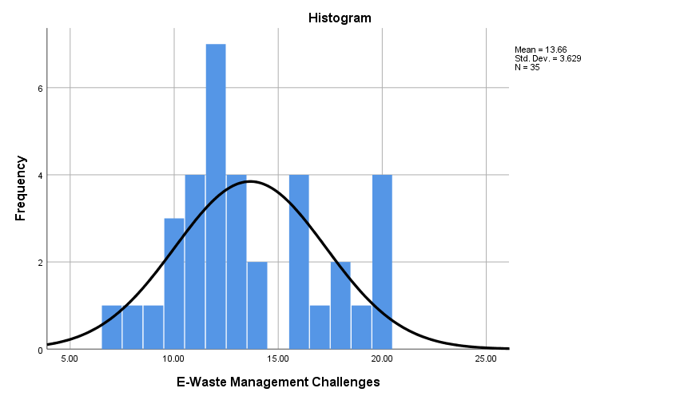
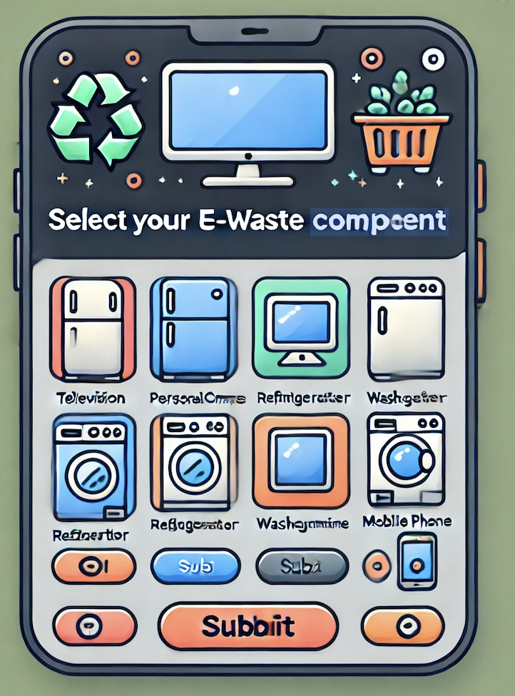
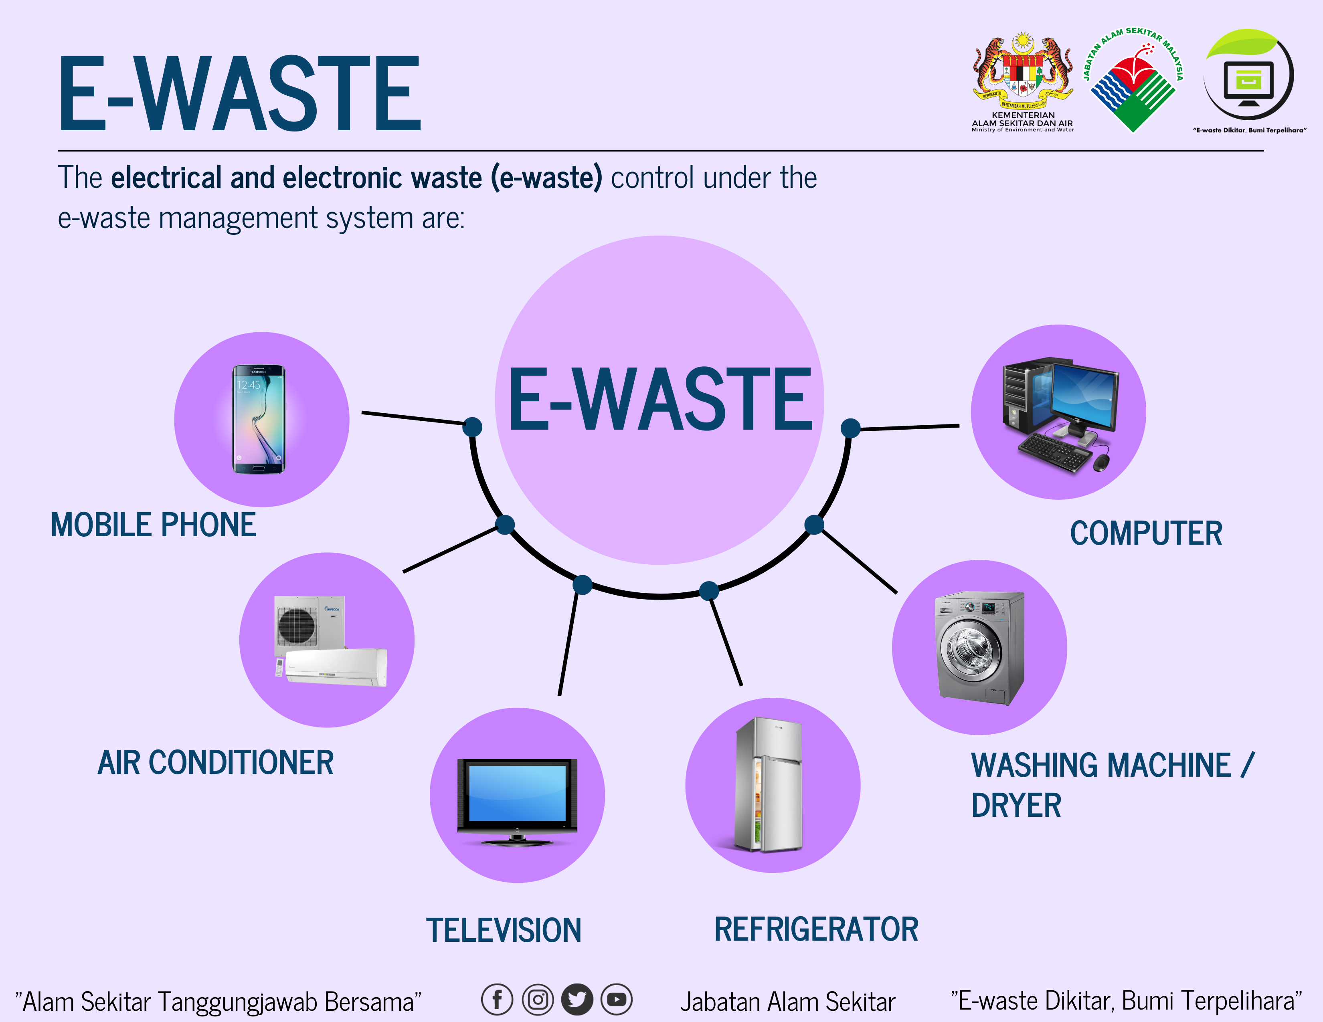
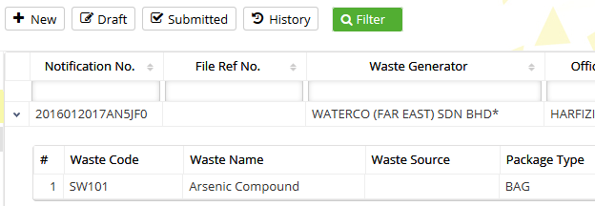
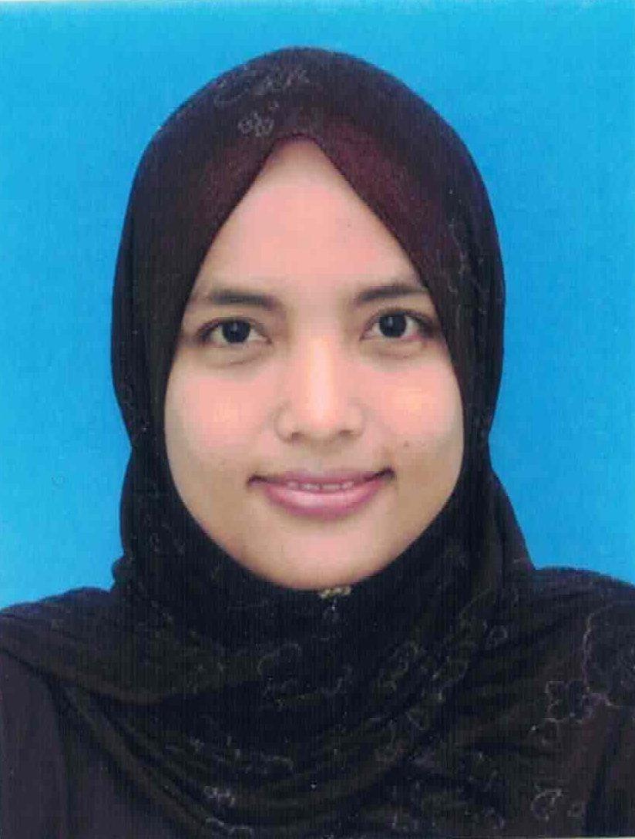
INTEGRATING HOUSEHOLD E-WASTE WITH GENERATOR, COLLECTION CENTER AND RECOVERY FACILITIES FOR IMPROVEMENT OF SCHEDULED WASTE MANAGEMENT IN MALAYSIA
MASTER IN ENVIRONMENTAL ENGINEERING (MEE)
Department of Chemical and Environmental Engineering, Faculty of Engineering, UPM
INTRODUCTION
OBJECTIVE
Source: DOE Malaysia
Evaluate awareness among the Malaysian public regarding the environmental impact of improper household E-waste disposal and Examine whether households comply with proper E-waste disposal practices as outlined in the Environmental Quality (Scheduled Wastes) Regulation 2005; and
Propose innovative solutions for enhancing household E-waste management.
METHODOLOGY
Survey
&
Questionnaires
Household
Formal Collection
Pre-test & Pilot-test
E-Waste Campaign
Partial/Fully Recovery Facilities
Collection Center
Site Visit
Observation
MyEwaste
ESWIS
Integrated System
Statistical
Analysis
(IBM SPSS version 25)
RESULT & DISCUSSION
Figure 5: Total perception score for awareness and understanding of e-waste regulations
Figure 6: Total perception score for collection and handling procedures
Figure 1: Various disposal methods by respondents
Figure 2: Percentage of disposal e-waste to the collector
Figure 7: Total perception score for public engagement and participation
Figure 8: Total perception score for e-waste management challenges
Disposal
Record the Waste Generated
Approval Status
Report
Step 1 :
Install MyEWaste
Application
Step 2 :
Click “ESWIS Module”
Step 3 :
“Choose Items”
Step 4 :
Record the
E-Waste Generated
Step 5 :
Choose Nearby Collection Center
Rewards
Figure 3: Correlation Between Knowledge About Electronic Waste and Disposal Methods
Figure 4: Correlation Between Income Level and Disposal Methods
Step 6 :
Submit Your Application
Step 7:
User can check approval status, report & rewards
Figure 9: Integrating system with ESWIS and MyEwaste
CONCLUSION
The study highlights moderate public awareness of the environmental impacts of e-waste with significant knowledge gaps about Malaysia's regulatory framework and formal collection centers. By assessing disposal patterns, operational challenges and the effectiveness of awareness campaigns, the study provides actionable insights for improving public awareness, strengthening regulatory enforcement and upgrading infrastructure to create a more sustainable and efficient e-waste management system in Malaysia.
Assoc. Prof. Ir. Dr. Shamsul Izhar Bin Siajam, PhD
Senior Lecturer
Siti Noor Shazilla Binti Zaki
GS 68349

