Slide 1
THEMATIC SESSION 1
YOUTH AND SUBSTANCE ABUSE

Slide 2
Speaker 1
Prof. Dr. Haslinda Abdullah
Director
Institute of Social Science,
Universiti Putra Malaysia
Prof. Dr. Haslinda is specialized in applied psychology

Slide 3
Emerging Positive Education Intervention for Clean Sport Behavior
Doping damages athletes’ physical health and sports integrity, replacing fair competition with a false feeling of strength. Besides, young athletes are more prone to harmful behaviors when they do not have a solid ethical basis to guide them.
Therefore, this study aims to assess the effectiveness of positive education intervention to focus on teaching them important lessons about fair play and value of competition while enhance the sports values and favorable attitudes towards doping.
A total of 40 young athletes were included in this study. A true-experiment pre-test post-test with control group design was conducted at Malaysia National Sport School. Experiment group has been given positive education intervention, while control group has not been given anything
The result indicates that clean sport likelihood, sport values, and knowledge about doping improved in experimental group compared to control group.

Slide 4
Introduction
Young athletes frequently have similar motives as they start their athletic careers (Chiang et al., 2018)
Young athletes are more prone to bad habits when they do not have a strong ethical foundation to guide them
Favorable outcomes may eventually develop into harmful ones as adults, such as the use of performance-enhancing substances, or "doping."
This issue is particularly acute among Malaysian adolescents, as research has highlighted the elevated risk of consuming harmful substances, encompassing both doping and non-doping substances
The area of most concern for us is young athletes who have not made it to the top, who are attempting to make that breakthrough and are prone to use drugs since it is a shortcut, according to a 2015 statement made by the previous director general of WADA (Nicholls et al., 2020).

Slide 5
Research Problem
A viable substitute is provided by positive psychology, an approach that investigates the factors influencing both individual and collective well-being. It implies that it is crucial to comprehend clean behavior and athletes' well-being (Singler, 2015).
The PERMA Model (Seligman, 2018) is one positive psychology framework that sheds light on players' happiness and well-being in addition to clean athletic behavior. This strategy can change the conversation from doping to clean behavior, which is frequently disregarded.
This study thus represents one of the first attempts to use the PERMA model in the Malaysian setting, with a particular emphasis on young athletes. The positive education intervention used in this study, based on the PERMA model, seeks to find successful ways to clean athletes to maintain their commitment to ethical athletic conduct.

Slide 6
Objective
Hypothesis
To develop a positive education intervention program grounded in PERMA model for Malaysian young athletes.
To compare the effectiveness of positive education intervention on clean sport behavior between experiment and control groups.
H1: There will be significant difference in clean sport behavior scores between experiment group and control group.
H2: Positive education intervention will lead to significant reduction in favorable attitudes towards doping among young athletes in experiment group compared to control group.

Slide 7
Perma Model
by Seligman, 2018
P
Encourage optimism creates a climate of passion and moral behavior in sports
ositive Emotion
E
Encourages players to respect the fundamental principles of sportsmanship and fair play as well as to enjoy the inherent joy of the game
ngagement
R
Respect for and commitment to the rules of fair competition are more likely to be fostered by athletes who value these connections with both rivals and teammates
Positive
elationship
M
Gives sports a deep purpose and encourages athletes to approach their athletic pursuits with a clear knowledge of the moral principles entwined with ethical sports behavior
eaning
A
Gives athletes a strong sense of accomplishment when they strive for notable accomplishments through moral methods
ccomplishment

Slide 8
Methodology
True-experiment pre-test and post-test (repeated measurements)-control group design

Slide 9
Intervention Activities
Objectives of activities | Types of activities
1. Promote engagement and intrinsic motivation 2. Building resilience for clean sport behavior | 1. Talk session about intrinsic and extrinsic motivation and resilience 2. Time for reflection and resilience plan
1. Building trust and mutual respect in sports 2. Conflict Resolution Training for Ethical Sportmanship | 1. Talk session about building trust and mutual respect in sports 2. Reflection time
1. Connect ethical behavior to meaning and personal growth 2. Inspiring ethical sportsmanship | 1. Talk session about meaning in sports tied to ethical behavior 2. Reading time: “Clean Sport Comic”
1. Measuring ethical success in sports 2. Builfing a culture of ethical acheivement in sports | 1. Talk session about accomplishment in context of ethical behavior and preventing doping 2. Reflection time

Slide 10
Intervention Activities
Control group
Experiment group

Slide 11
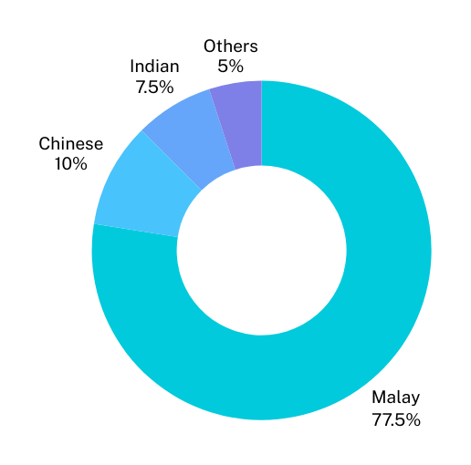
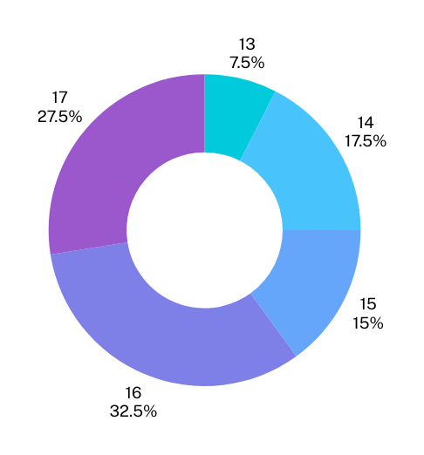
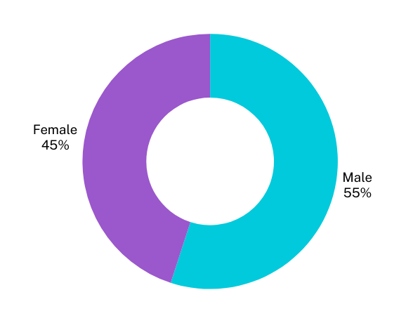
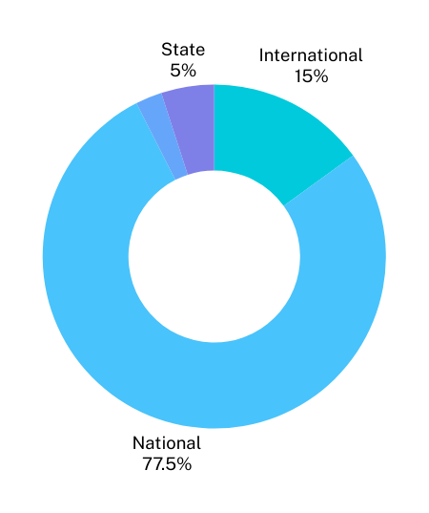
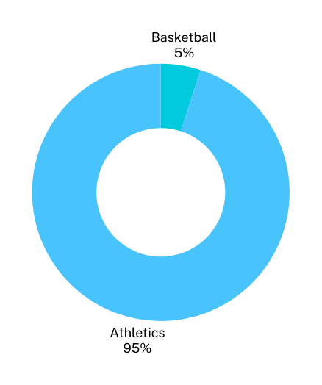
Results
Gender
Ethnicity
Age
Type of sports
Level competing in sports

Slide 12
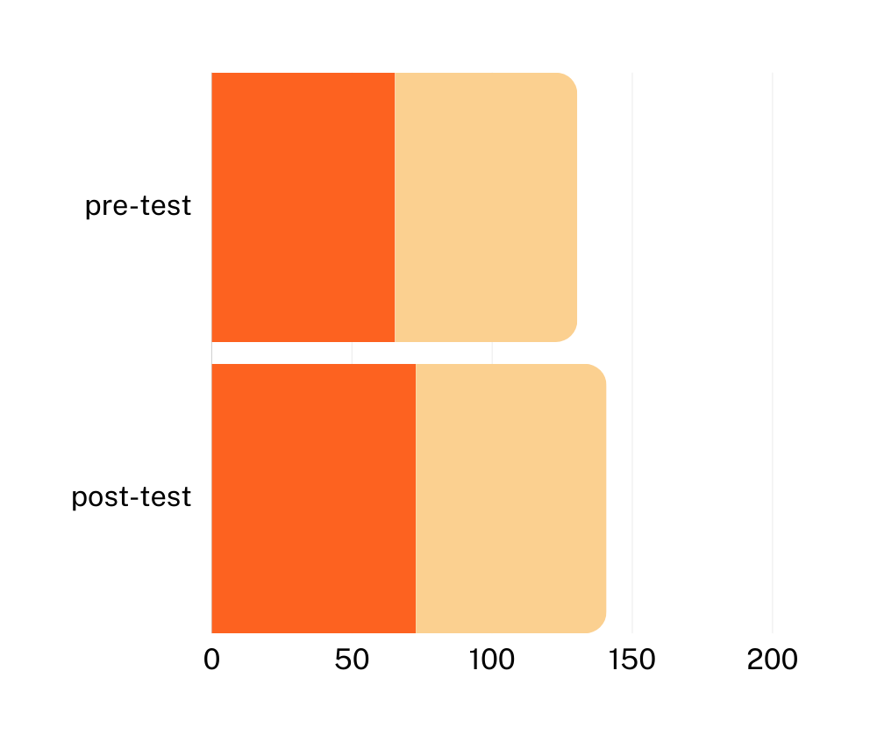
Analysis
Mean scores increased from 65.4(SD=8.7) at pre-test to 72.8(SD=7.9) at post-test for experimental group
Value F (df=1,38, p=0.03) was significant, leading to rejection of H0
This indicates that positive education program effectively improves sports values and reduces favorable attitudes towards doping among young athletes in experimental group
Experimental group
Control group
Mean scores for control and experimental group

Slide 13
Conclusion
The experimental group had notable changes as a result of positive attitudes promoted by positive education intervention program, which includes components of Positive Emotion (P), Engagement (E), Positive Relationship (R), Meaning (M) and Accomplishment (A).
The intervention can empower young athletes and assist development of habits that improve their general well-being by wisely promoting positive values.
School-based doping prevention intervention program has proved to be feasible and effective in increasing knowledge, reducing favorable attitudes towards doping, and enhancing clean sport values.
Future studiess should look at longer intervention periods and bigger sample numbers to understand the long-term advantages of positive education intervention for promoting clean sport in young athletes.

Slide 14
Thank you

