Slide 1

Preserving Your Research Legacy :
The Essentials of Self-Archiving
Mohamad Syahrul Nizam bin MD Ishak
Librarian (S41)
Digital Resource Management Division
Perpustakaan Sultan Abdul Samad

Slide 2





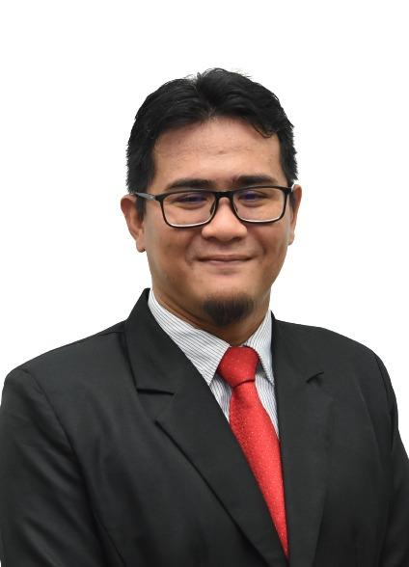
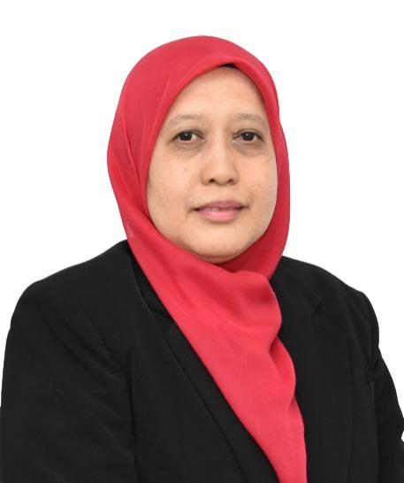




Digital Resource Management Division
RUSNIAH SAYUTI
DIGITAL DISSERTATION SECTION
REPOSITORY SECTION
AZIAN EDAWATI ZAKARIA
MOHAMAD JEFRI MOHAMED FAUZI
NURAIDA IBRAHIM
MOHAMAD SYAHRUL NIZAM MD ISHAK
ROHANA ALIAS
ZAIMAH SAIFUL YAZAN
CHE WA ZAKARIA
NUR AINA AHMAD MUSTAFA
NUR FASEHA MOHD KADIM

Slide 3


UPM Institutional Repository (UPM IR)
An online archive that serves as a center for the collection, storage, and dissemination of research information at UPM.
Research documents and writings produced by the UPM community or in collaboration with other researchers.
http://psasir.upm.edu.my/
Provides free and unlimited access and can be used for research or learning purposes.

Slide 4
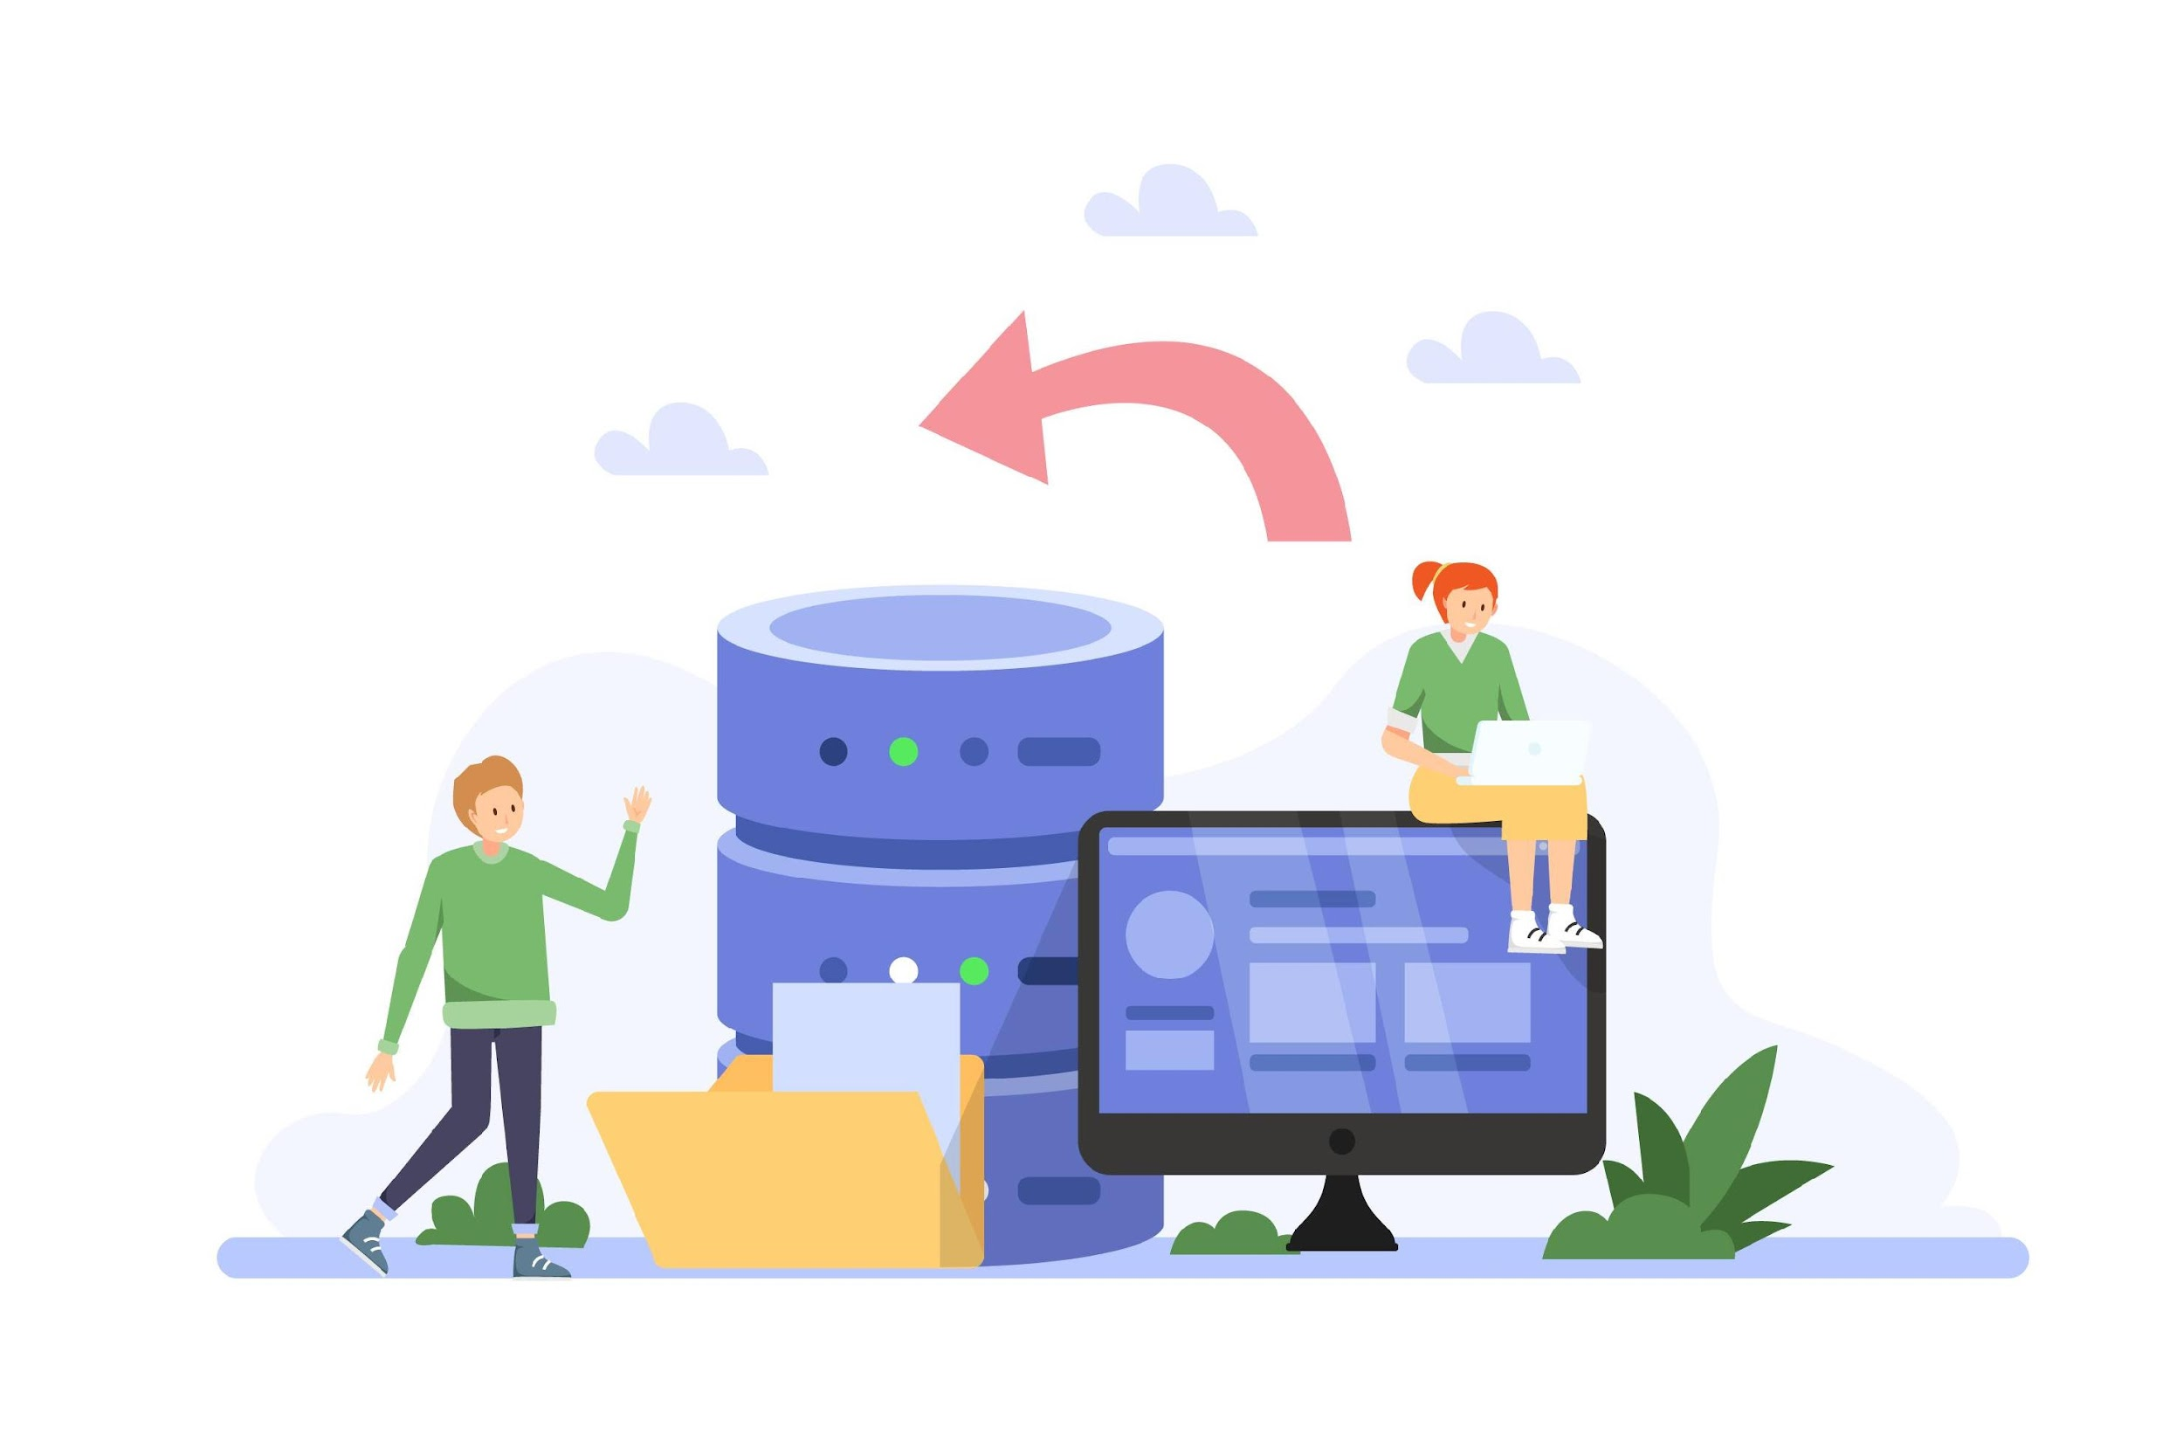
UPM Institutional Repository (UPM IR)
Objective
To preserve the results of scientific study or UPM intellectual property digitally
To increase the number of cite articles on UPM scientific study
To contribute to a network of partnership and exchange scientific information produced by researchers in the same field
To promote and provide an open access to the UPM scientific study results globally
To increase UPM’s visibility and prestige globally

Slide 5

Type of Collection
Research Directory
Articles
Teaching Material
Books
Thesis (Master / Phd)
Chapters in books
Project Report
Journals
Press Clippings
Patent
Magazines And Newsletters
Inaugural Lectures
Annual Report
UPM News
UPM IR
Monograph
Conference Papers
Malay Manuscripts

Slide 6






UPM Institutional Repository (UPM IR)
Indexed by

Slide 7
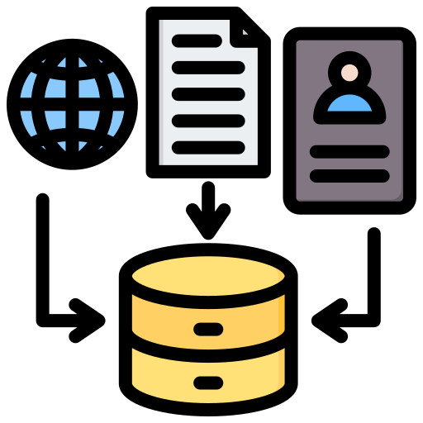



UPM Institutional Repository (UPM IR)
91K
89%
79%
11M
Items
Full Text
Open Access
Downloads

Slide 8
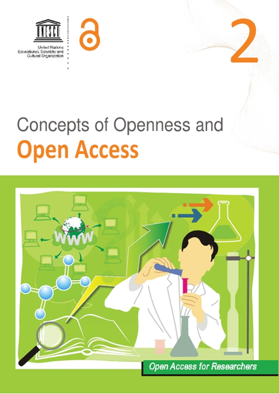

Self-Archiving
"Self-archiving is described as ‘the act of depositing a free copy of an electronic document on the world wide web in order to provide open access to it’" (Harnad, 2001)
Self-archiving – refers to making a work published with a publisher available to the public in an institutional or disciplinary open access repository. Self-archiving can take place at the same time as the publication of the content by the publisher or at a later date, and is possible for preprints and post-prints of scholarly articles, as well as for other document types, for example, monographs, research reports, and conference proceedings.
(Open Access Network)

Slide 9




Self-Archiving @ UPM IR
PSAS attempts to obtain, compile, store, preserve research data and information. Subsequently disseminating it to users in a more effective and timely manner.
You are now able to contribute your works by using the self-archiving Platform. By doing this, it will assist us in expanding the digital archive collection which is beneficial for both UPM and researchers.
We strongly believe that your contribution will have huge positive impacts to UPM as a whole.

Slide 10

Preservation of UPM intellectual property in digital format
1
Self-archiving
Empowering researchers in terms of knowledge, resource sharing, ideas and expertise
2
bjectives
3
Promotes and provide open access platform with the aspiration of globally increasing the impacts of UPM’s researchers visibility and prestige
4
Striving to improve UPM in the Webometrics Ranking of World Universities.

Slide 11





Increased Visibility
Open Access Contribution
Makes your research more accessible to researcher, increasing the chances of citations and recognition.
Allows you to share your work freely, promoting knowledge-sharing and broadening the reach of your research.
Self-archiving
Wider Audience Reach
Long-Term Preservation
Enables researchers, practitioners, and the public to access your work without paywalls.
Ensures your work is stored in university repository, safeguarding it for the future.

Slide 12
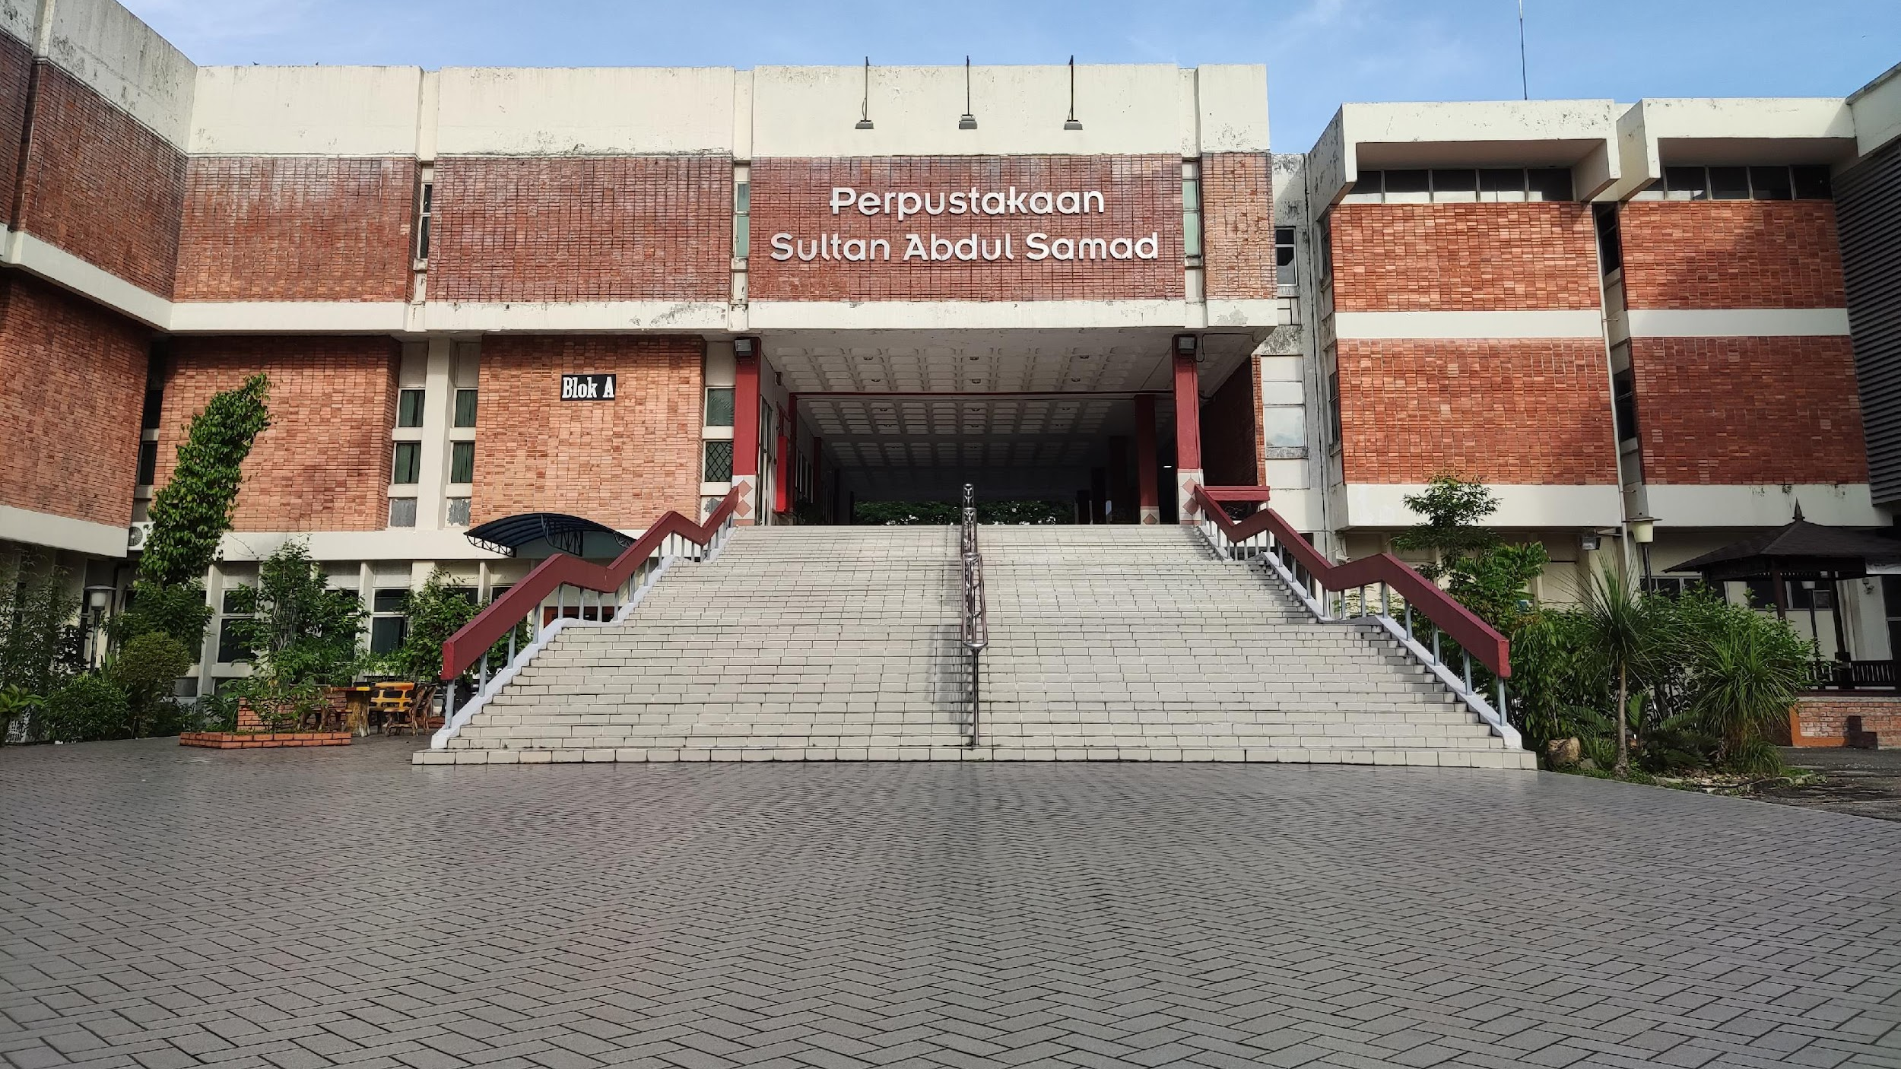
OUR HOPE
Our hope is not only to preserve articles but also to actively promote them, ensuring they are accessible and beneficial to the widest possible audience of researchers. We are committed to supporting universities in enhancing the visibility and impact of their research, contributing to the advancement of knowledge and academic excellence.

Slide 13

UPM IR Top Downloaded Article
1 | Renewable energy policy and initiatives in Malaysia (2006) Faculty of Design and Architecture | 45,870
2 | Tahap keprihatinan alam sekitar dan amalan kepenggunaan hijau pengguna di Petaling Jaya, Selangor (2006) Faculty of Human Ecology | 27,725
3 | Determination of Vitamin C in Fresh Fruits and Vegetables Using the Dye-titration and Microfluorometric Methods (1988) Institute for Medical Research (Published on Pertanika) | 26,256
4 | Hubungan keberkesanan latihan dengan prestasi kerja (1988) Faculty of Educational Studies | 24,981
5 | Design and Simulation of Plastic Injection Moulding Process (2004) Faculty of Engineering | 23,656

Slide 14




Self-Archiving Statistic 2024
319
Full-text
304
Articles
8
Book Sections
3
Abstracts
2
Slides Presentation
1
Book
1 Newspaper Articles
217 Open Access
19 Green OA
223
Depositor
83 Closed Access

Slide 15

What can you deposit?
MATERIALS
Article
Book
Newspaper
Book Section
/ Chapter
Magazine / Newsletter
Patent
Journal / Bulletin
Inaugural Lecture
Conference Paper

Slide 16
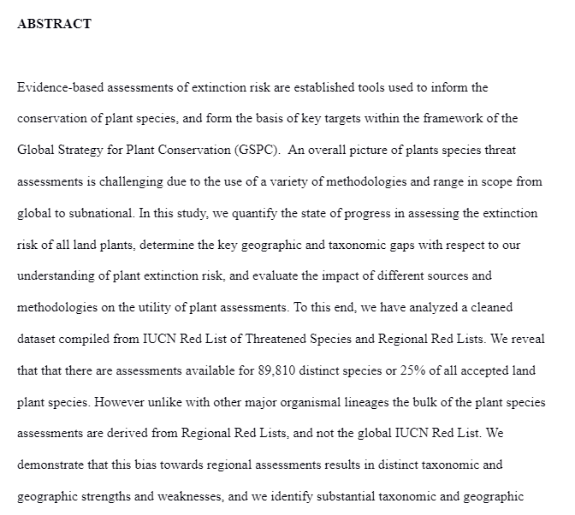
What can you deposit?
Versions of an Article
SUBMITTED / PREPRINTED
Draft of the manuscript before formal peer-review, or the first version sent to the journal for consideration.
APPEARANCE:
Unformatted – The document is unformatted, with the font, line spacing, and overall style reflecting the author’s personal preferences rather than any formal guidelines
Draft – The manuscript is in a draft state, with content that is often raw and subject to further revision during the peer review process.
Reference list – The references are listed in a casual manner, often with minimal formatting, and may not yet adhere to the strict guidelines required by the final publication.

Slide 17
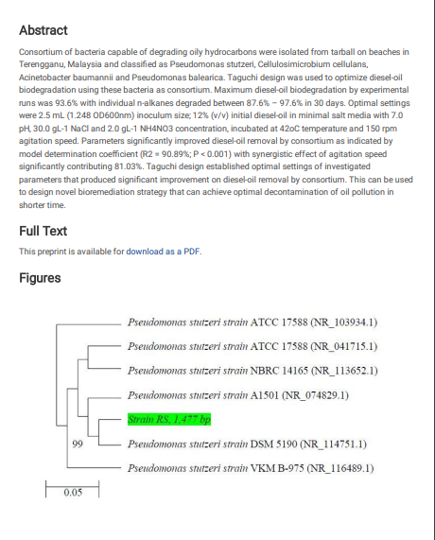
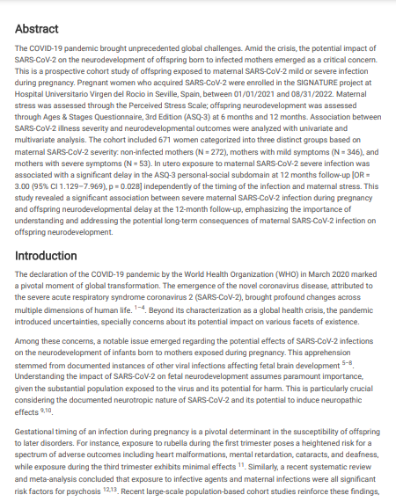
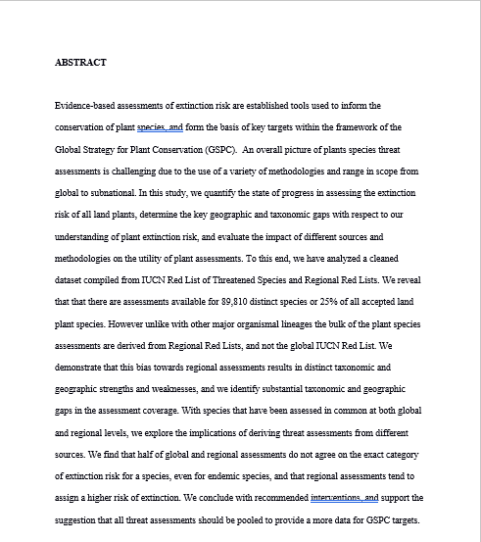
What can you deposit?
SUBMITTED / PREPRINTED
EXAMPLES
https://doi.org/10.21203/rs.3.rs-107265/v1
https://doi.org/10.21203/rs.3.rs-4782550/v1
https://doi.org/10.5281/zenodo.1197399

Slide 18
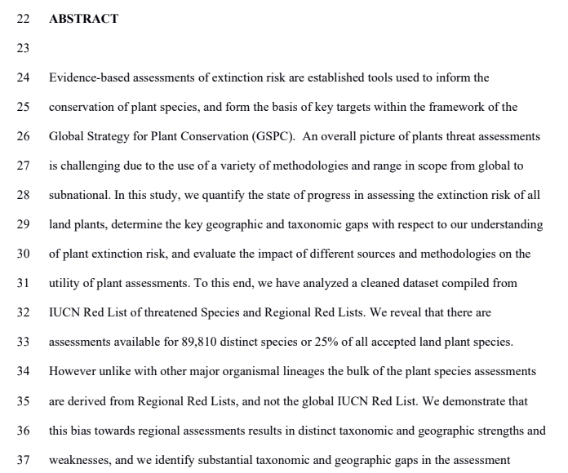
What can you deposit?
Versions of an Article
ACCEPTED / POSTPRINT
Final version of the manuscript after formal peer-review but before being type-set by the publisher. It contains all revisions made during the peer-review process.
APPEARANCE:
Peer-reviewed and revised - The manuscript has undergone peer review, with content revised based on reviewer feedback. It is considered the final version by the author, pending any final formatting adjustments by the journal
Branding – Typically no journal information and branding such as journal name, volume and issue.
Formatting - Usually double-spaced, might have corrections on the sides.

Slide 19
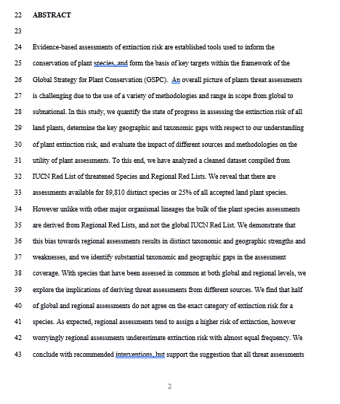
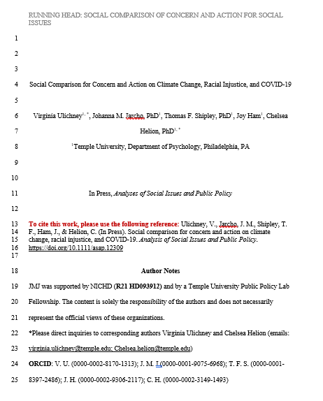
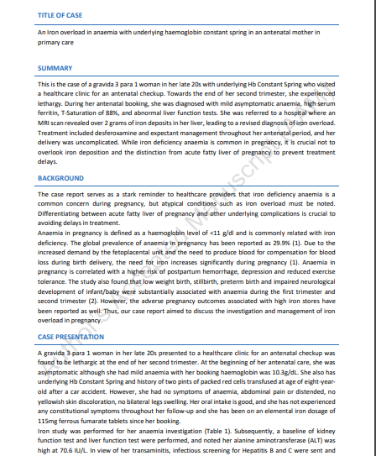
What can you deposit?
ACCEPTED / POSTPRINT
EXAMPLES
https://doi.org/10.5281/zenodo.1197396
http://hdl.handle.net/20.500.12613/7947
http://psasir.upm.edu.my/id/eprint/112149/

Slide 20
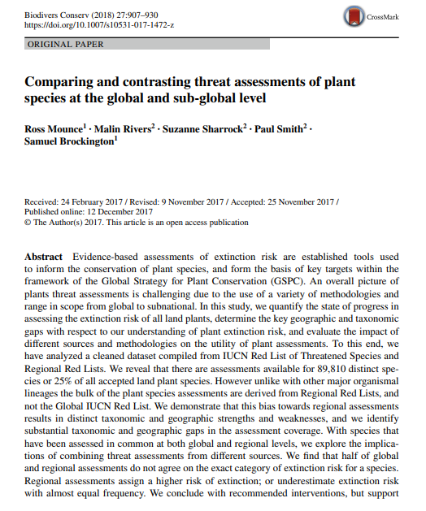
What can you deposit?
Versions of an Article
PUBLISHED / VERSION OF RECORD
Version of the manuscript published in a journal with the journal's type-set and branding
APPEARANCE:
Branding - The manuscript features the journal’s branding, including the logo, and information such as volume, issue number, and page numbers.
File- The published version is commonly provided as a PDF file.
Formatting The document adheres to the journal’s specific formatting guidelines, including font type, size, spacing, and layout. This includes professionally formatted figures, tables, and references according to the journal's style.

Slide 21





HOW TO CHOOSE WHICH VERSION TO ARCHIVE?
CHOOSING THE VERSION IS CRUCIAL!!
It determines how widely your work can be accessed and downloaded. Archiving the correct version is essential to comply with publisher policies and ensure that your research reaches the broadest possible audience. Depositing the wrong version could restrict access to your work, keeping it behind paywalls and limiting its potential impact.

Slide 22
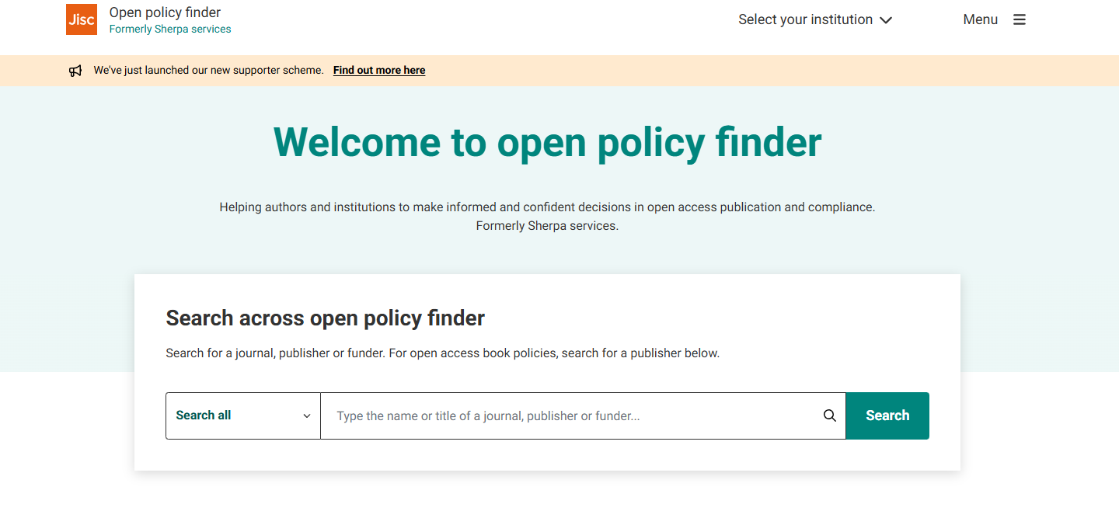
HOW TO CHOOSE WHICH VERSION TO ARCHIVE?
USING OPEN POLICY FINDER TO CHECK VERSION POLICIES
Open Policy Finder is a tool that helps researchers determine what versions of their articles can be archived based on the publisher’s policies.
By entering the journal's name into Open Policy Finder, you can quickly find out whether you can archive the submitted, accepted, or published version of your work, as well as any restrictions or embargoes that apply.
All the information provided by Open Policy Finder is correct to the best of its knowledge but should not be relied upon for legal advice.
https://openpolicyfinder.jisc.ac.uk/

Slide 23








How Do Publishers Handle Self-Archiving?
DEPOSIT PUBLISHED VERSION

Slide 24



How Do Publishers Handle Self-Archiving?
PUBLISHER SELF-ARCHIVING POLICY
 | Preprint / Submitted version | Postprint / Accepted version | URL
 | Status: Allowed Condition: Link to publication | Status: Allowed Condition: After embargo (12-24 month) | https://www.elsevier.com/about/policies-and-standards/sharing
 | Status: Allowed Condition: Link to publication | Status: Allowed Condition: After embargo (6-12 month) | https://www.springernature.com/gp/open-research/policies/journal-policies https://www.springer.com/gp/editorial-policies/preprint-sharing
 | Status: Allowed Condition: No condition | Status: Allowed Condition: After official publication | https://www.emeraldgrouppublishing.com/sites/default/files/2020-08/how-to-share-your-Emerald-article.pdf
 | Status: Not Allowed after official publication | Status: Allowed Condition: After embargo (24 month) | https://journals.ieeeauthorcenter.ieee.org/become-an-ieee-journal-author/publishing-ethics/guidelines-and-policies/post-publication-policies/

Slide 25


Typical Conditions for Depositing Articles
WORK PUBLISHED IN AN OPEN ACCESS JOURNAL
PUBLISHED VERSION
WORK PUBLISHED IN AN SUBSCRIPTION-BASED JOURNAL
ACCEPTED VERSION

Slide 26
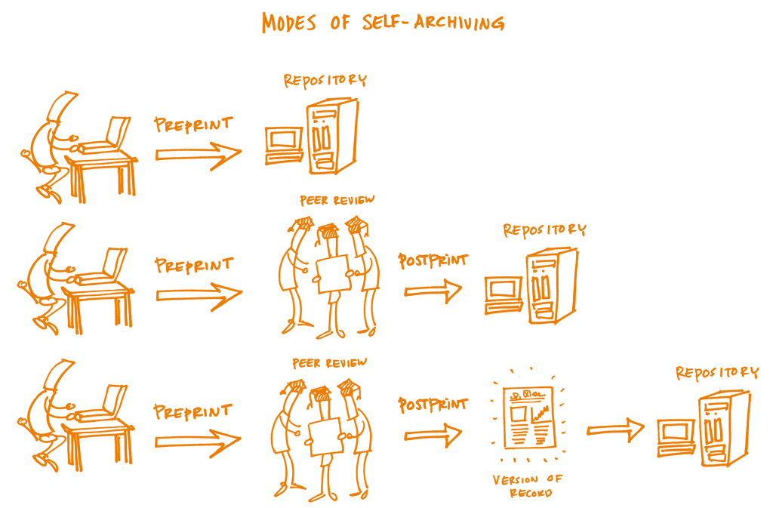
How Self-Archiving Works?

Slide 27



HANDS-ON DEMONSTRATION
URL : http://psasir.upm.edu.my/
Account:
Username: upmir2
Password: upmir2_123
Manual: https://bit.ly/self-archive-upmir

Slide 28
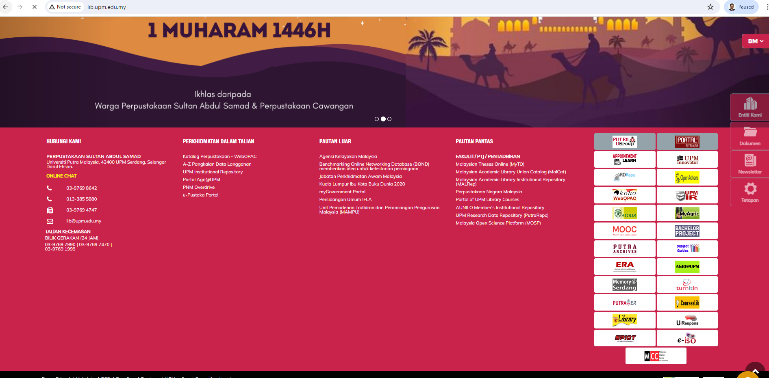


How to self-archive?
Step 1:
Access UPM IR
Visit: http://www.lib.upm.edu.my/
Scroll
Down
Click icon
OR
http://psasir.upm.edu.my

Slide 29

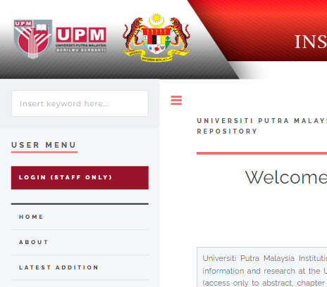
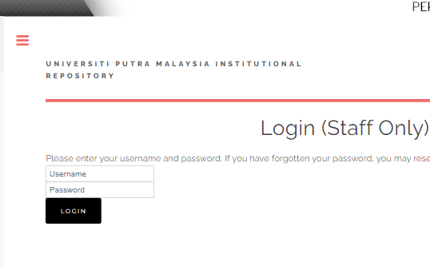
How to self-archive?
Step 2:
Click then enter username and password
1. Click Login (Staff Only)
2. Enter username
eg: upmir2
3. enter password
eg: upmir2_123
4. Click Login

Slide 30
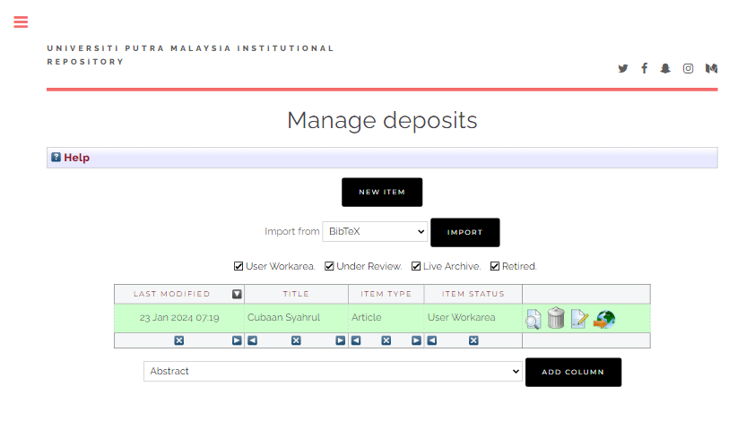

How to self-archive?
Step 3:
Click

Slide 31
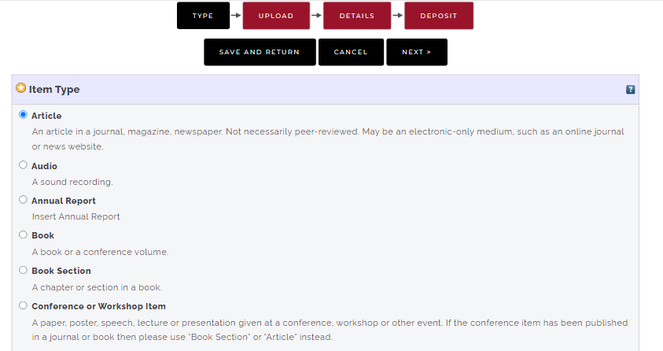
How to self-archive?
Step 4:
Select Item Type

Slide 32
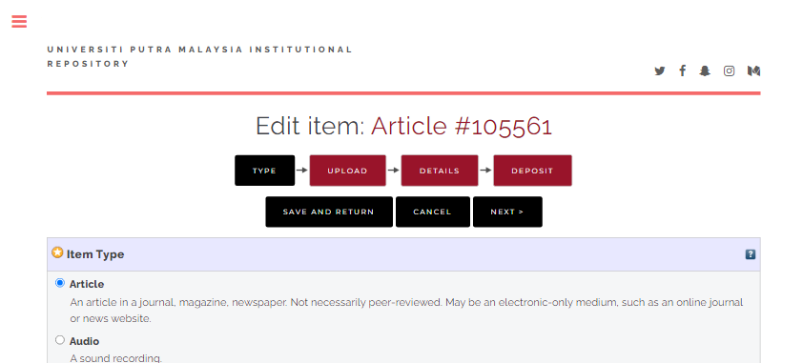
How to self-archive?
Step 5:
Click

Slide 33
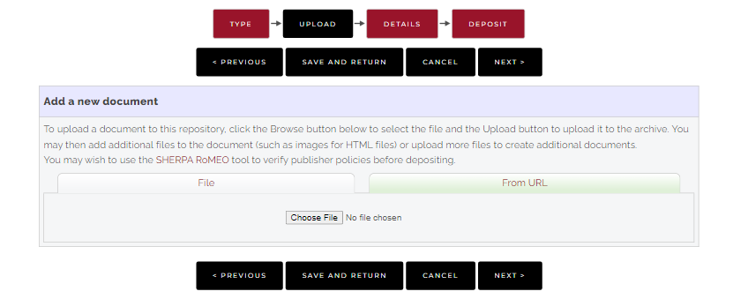
How to self-archive?
Step 6:
Click

Slide 34
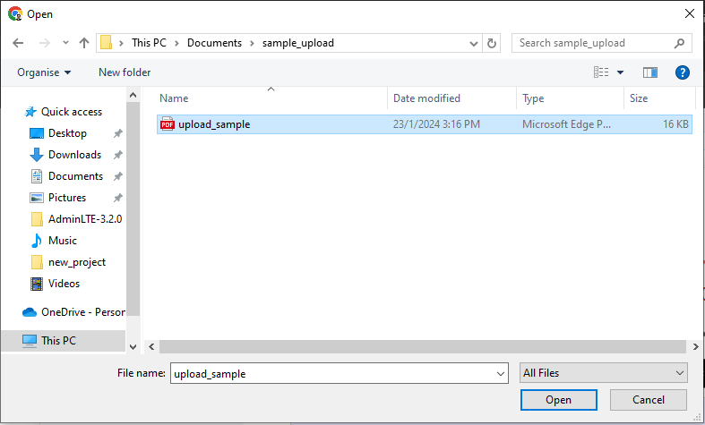
How to self-archive?
Step 7:
Select article to be uploaded and click Open
Select article
2. Click open

Slide 35
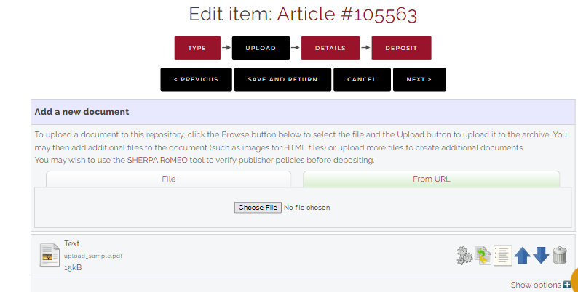
How to self-archive?
Step 8:
Wait until the upload process complete and click
1. Verify the file uploaded
2. Click Show options

Slide 36

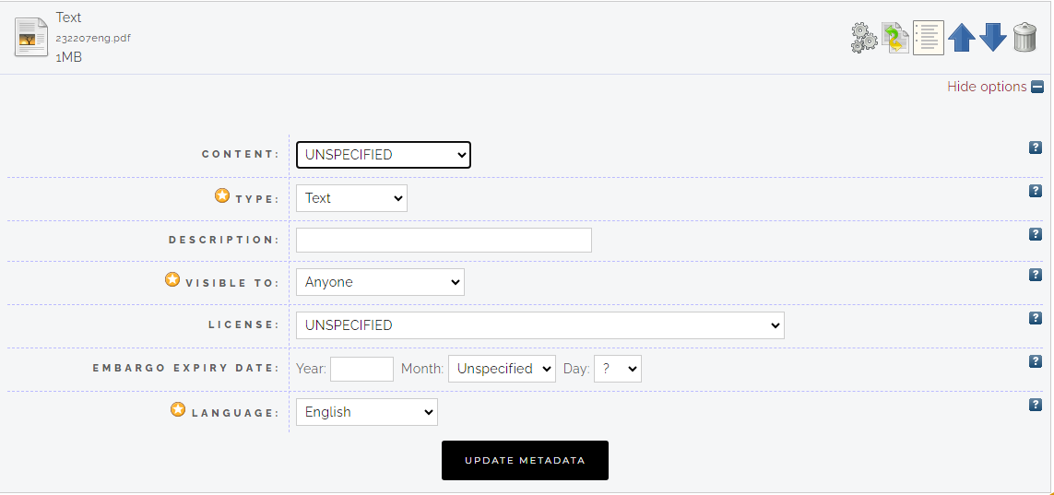
How to self-archive?
Step 9:
Fill up article information then click
1. Select article version
2. Insert note
(if any)
3. Select “Repository staff only”
4. Fill embargo date
(If any)
5. Click Next to continue

Slide 37

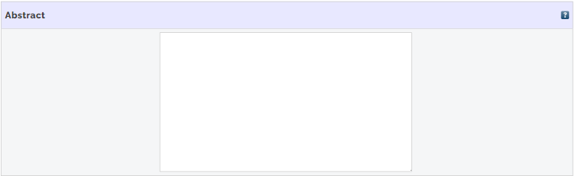
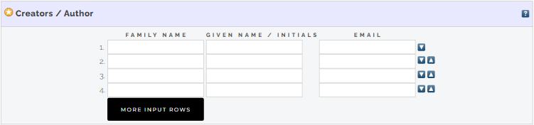
How to self-archive?
Step 10:
Fill up article metadata

Slide 38
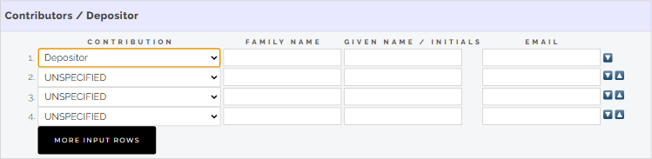
How to self-archive?
Step 10:
Insert depositor name
1. Select Depositor
2. Fill up name

Slide 39
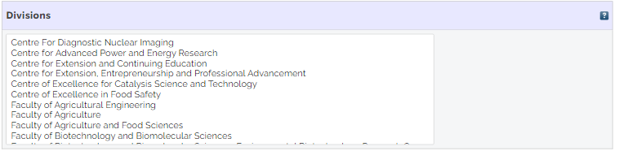
How to self-archive?
Step 10:
Fill up article metadata

Slide 40
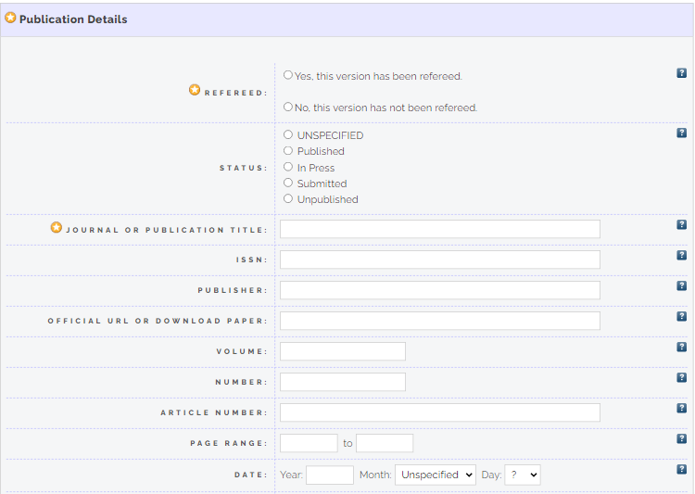
How to self-archive?
Step 10:
Fill up article metadata

Slide 41
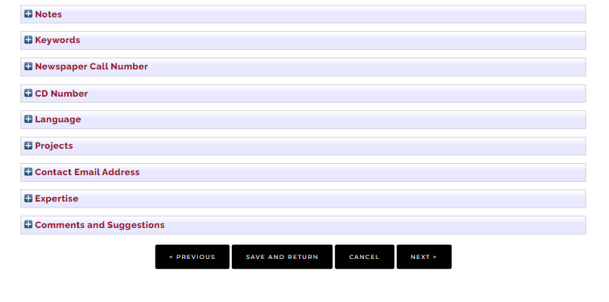
How to self-archive?
Step 11:
Click next to continue
Klik Next to continue

Slide 42

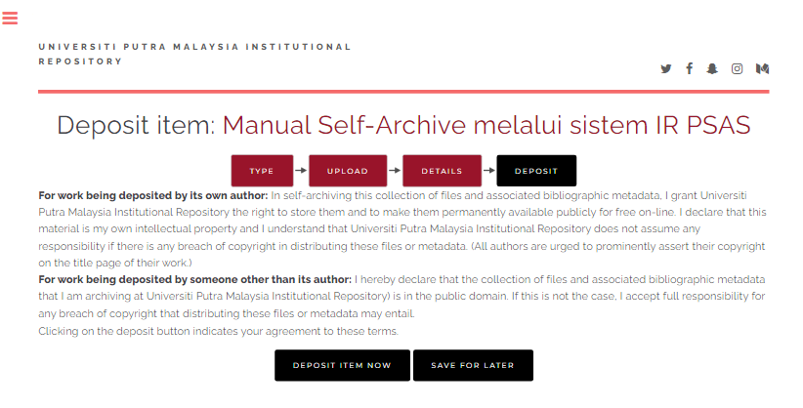
How to self-archive?
Step 12:
Click to complete the process

Slide 43
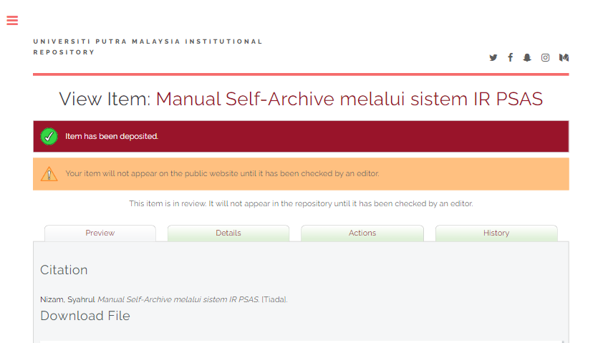
How to self-archive?
Step 13:
Process complete

Slide 44

Contact
NURAIDA IBRAHIM
Pustakawan Kanan (S44)
Telefon : 03 9769 8449
Email : nuraida@upm.edu.my
MOHAMAD JEFRI MOHAMED FAUZI
Pustakawan Kanan (S44)
Telefon : 03 9769 8629
Email : mf_jefri@upm.edu.my
MOHAMAD SYAHRUL NIZAM MD ISHAK
Pustakawan (S41)
Telefon : 03 9769 8617
Email : syahrulnizam@upm.edu.my

Slide 45
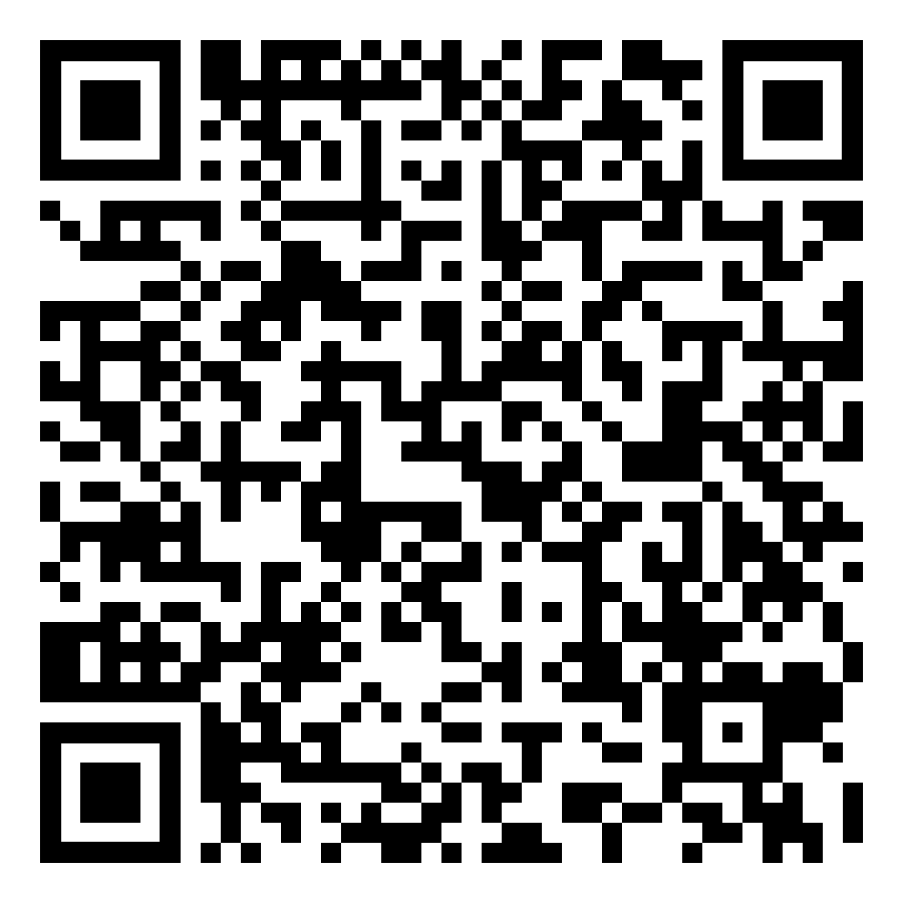
Register Now!
Start self-archiving today and make your research openly accessible.

Slide 46

Thank You

